Slide 1

Hospital General
Information Dashboard
Power BI Capstone Project | HeroVired Data Analytics
Team Members
Akash · Data Engineering
Arunima · Data Modeling & Visuals
Manisha · Performance & Validation
Anuj · What-If & Scenarios
Abhishek · Power BI Dashboard Development, Testing & Optimization, PPT Creation
June 2026 | Group Project Submission
Notes:
Welcome everyone. This is our capstone project for the HeroVired Data Analytics course.

Slide 2
Agenda
Project Objective
Dataset Overview
01
02
Problem statement & business goals
5,384 hospitals · 38 columns · 5 domains
Data Engineering
Data Modeling
03
04
Akash — Power Query cleaning steps
Arunima — Star schema & DAX measures
Dashboard Walkthrough
Performance & Validation
05
06
All 6 Power BI report pages
Manisha — Details & QA pages
What-If & Scenarios
Key Findings & Team
07
08
Anuj — Simulation & insights
Abhishek's design + team contributions
Notes:
Brief agenda overview.

Slide 3
Project Objective
Build an interactive Power BI dashboard using the
Hospital General Information dataset to enable:
Target Audience
🏥
📋
Assess hospital performance across 5 quality dimensions
(Mortality, Safety, Readmissions, Patient Exp, Timeliness)
Healthcare
Administrators
Policy
Makers
Compare hospitals by geography, type & ownership
📊
💡
Identify strengths and gaps in quality metrics
Data
Analysts
Quality
Improvement Teams
Enable dynamic "What-If" scenario simulation
for evidence-based decision making
Dataset: Hospital General Information (CMS)
Notes:
The project serves healthcare administrators, policymakers and analysts who need to make data-driven decisions.

Slide 4
Phase 1 — Data Engineering
Akash
Power Query Cleaning — 4 Steps
01
Primary Keys & Geography
02
Numerical Metrics Standardisation
Set Facility ID & ZIP Code to Text. Applied Trim & Clean.
Prevents leading-zero loss (e.g. '01052') and broken table joins.
Replaced 'Not Available' → null in ratings. Converted 19 measure columns to Whole Number. Used Replace Errors → blank nulls to avoid losing hospital records.
03
Categorical Data & Boolean Flags
04
UI/UX Model Optimisation
Parsed Emergency Services → True/False Boolean for slicer use. Kept all Footnote columns as Text to prevent accidental aggregation.
Hidden Address, Telephone & Footnote columns in Model View. Keeps field list clean for the viz team. Data remains available for DAX if needed.
✅ Dataset loaded with ZERO errors · All 20 numerical columns strictly typed · Facility ID clean and ready for Star Schema joins
Notes:
Akash spent significant effort on data quality — his null handling prevented record loss which was critical.

Slide 5
Phase 2 — Data Modeling & DAX
Arunima
Star Schema Data Model
DAX Measures Created
Dim_State
StateID (PK)
Dim_County
CountyID (PK)
Mortality (MORT)
Mort Better · Mort No Different · Mort Worse · Mort Better %
Many-to-One (*:1)
Single direction filter
Safety
Safety Better · Safety No Different · Safety Worse · Safety Better %
🏥 Hospital
(Fact Table)
PK: Facility ID
Readmissions
READM Better · READM No Different · READM Worse · READM Better %
4 dimension tables
Hospital = central fact
Dim_HospitalType
TypeID (PK)
Dim_Ownership
OwnershipID (PK)
KPI Measures
Total Hospitals · High Performing Hospitals · % High Performing · Average Better %
Challenge: Filled Map visual unavailable — used standard map. Rating required text→numeric conversion.
Notes:
Arunima built the star schema and all domain DAX measures that power the entire dashboard.

Slide 6
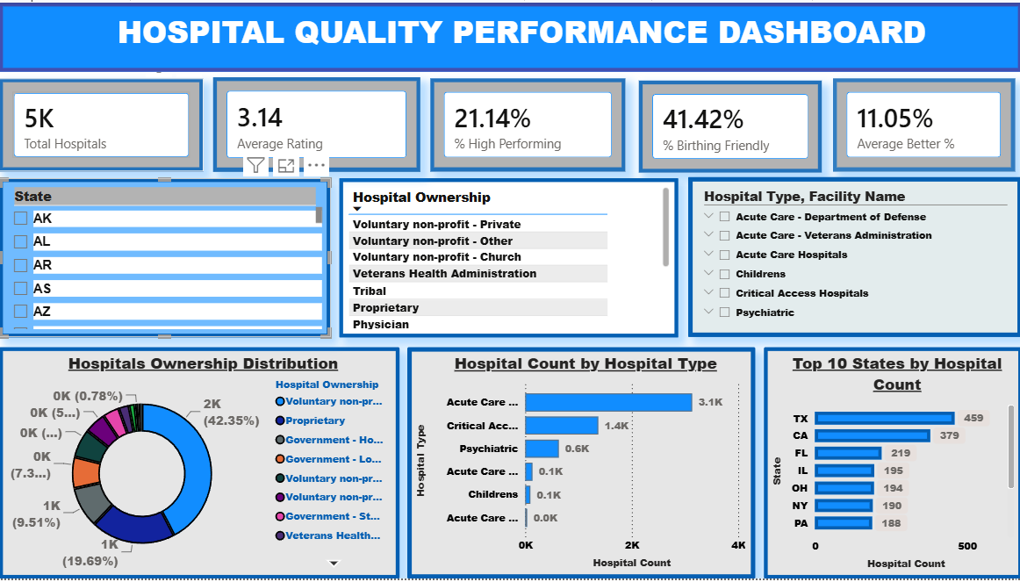
Page 1 — Hospital Quality Performance Dashboard
Overview
5K
Hospitals (AR filter)
3.14
Avg Rating
21.14%
High Performing
41042%
Birthing Friendly
11.05%
Avg Better %
Slicers: State · Hospital Type · Ownership
Notes:
Page 1 gives an executive overview. The AR state filter is active in this view.

Slide 7
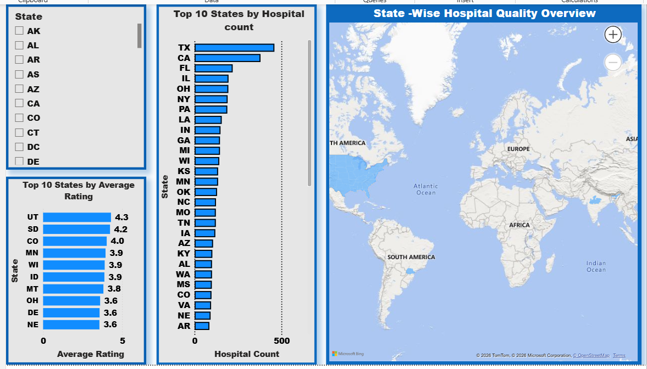
Page 2 — State-Wise Hospital Quality Overview
Geographic Analysis
🥇
Top State
Utah leads with avg
rating of 4.3
🗺️
Most Hospitals
Texas dominates
hospital count (459+)
📍
Map Visual
State-wise hospital
quality overview
⚠️
Challenge
Filled Map unavailable
Used Bing map instead
Notes:
Geographic page shows state-wise distribution. Team noted Filled Map wasn't available so used Bing maps.

Slide 8
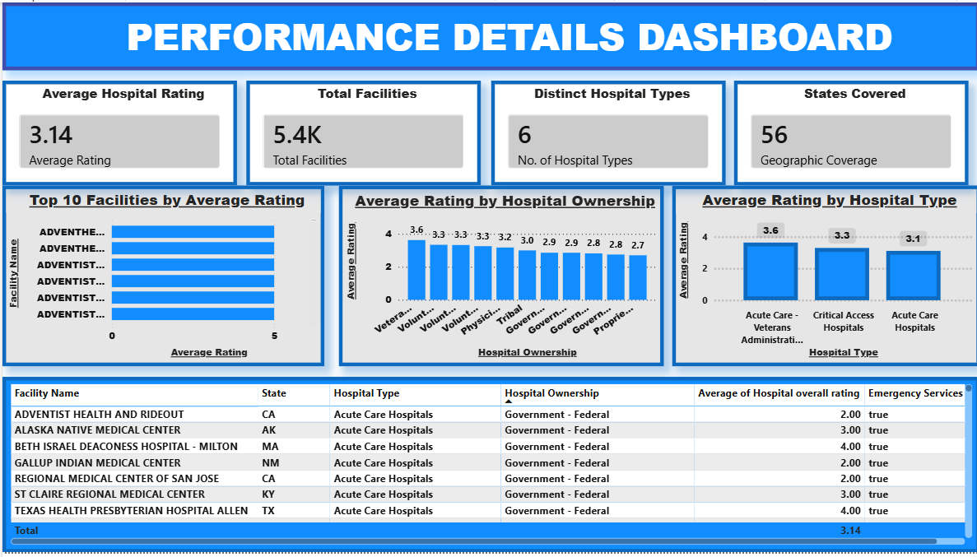
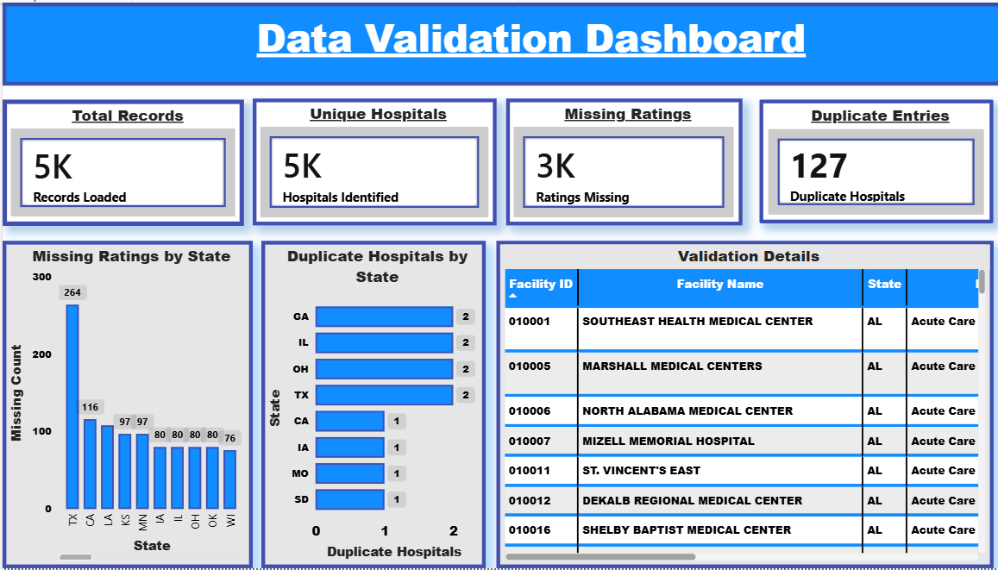
Phase 3 — Performance Details & Data Validation
Manisha
Performance Details Dashboard
Data Validation Dashboard
📊
Top 10 Rated Facilities · Avg Rating by Ownership · Avg Rating by Hospital Type
✅
Data Validation: 5K records · 5K unique hospitals · 3K missing ratings · 127 duplicates found
🔍
Target Rating What-If: dynamically shows hospitals above/below benchmark threshold
🛡️
QA page ensures data quality before business decisions are made
Notes:
Manisha built both the Performance Details and Data Validation pages — critical for trust in the dashboard.

Slide 9
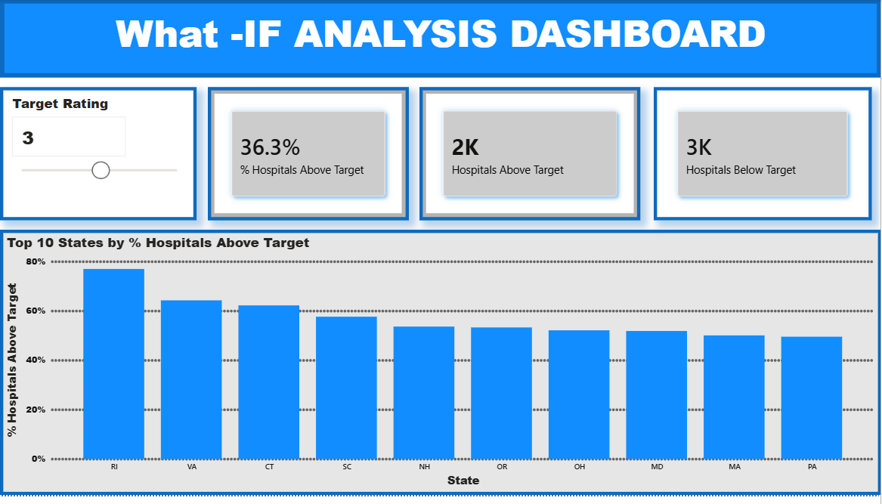
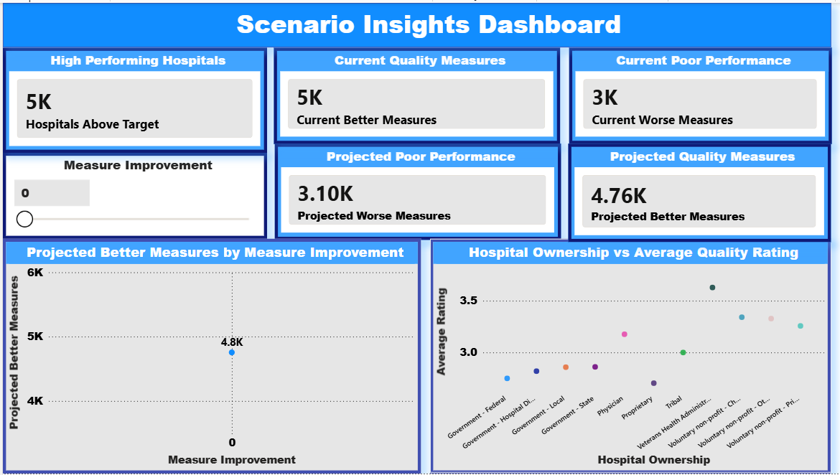
Phase 4 — What-If Analysis & Scenario Insights
Anuj
What-If Analysis Dashboard
Scenario Insights Dashboard
E.1 — What-If Parameter
F.1 — Scenario Insights
Dynamic Target Rating slider (1–5). Measures: Hospitals Above Target, % Hospitals Above Target, Hospitals Below Target
Projected Better/Worse Measures KPIs. Measure Improvement slider. Current vs projected comparison view.
F.2 — Interactivity
Business Insight
Cross-filtering, dynamic KPI cards responding to selections. Decision-support view for quality improvement.
RI leads with 75% hospitals above target (rating 3). Veterans Health Admin scores highest avg rating by ownership.
Notes:
Anuj's What-If module is the most interactive part — the slider lets users simulate improvement scenarios in real time.

Slide 10
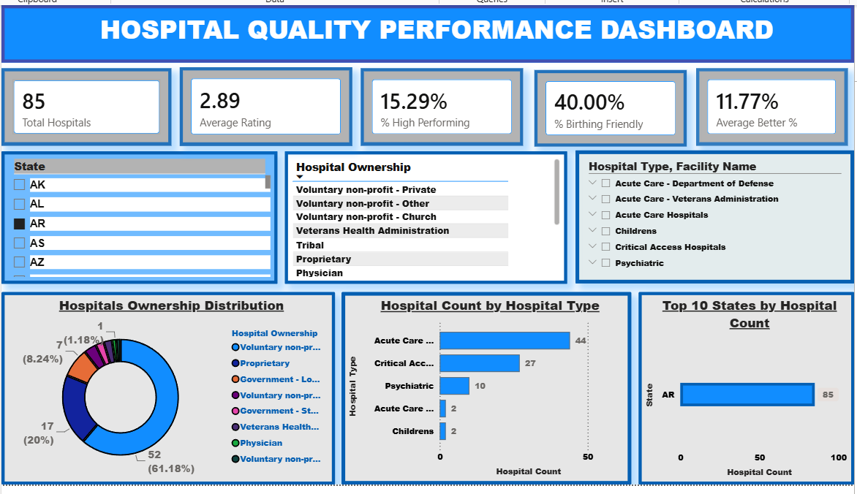
Dashboard Design & UX
Abhishek
All 6 Dashboard Pages — Built & Designed
Overview Dashboard
Geographic Analysis
What-If Analysis
Performance Details
Data Validation
Scenario Insights
Notes:
Abhishek built and styled all 6 dashboard pages including UX layout, card formatting, and chart selections.

Slide 11
Key Findings & Insights
🏆
🚨
✅
Top Performing States
Readmissions Gap
Safety is Strongest
Utah (4.3), South Dakota (4.2) & Colorado (4.0) lead avg hospital ratings — Western states dominate quality.
Highest 'Worse' domain at 8.4%. Texas alone has 264 missing ratings — biggest data quality gap by state.
17.1% of safety measures outperform national benchmarks — best 'Better' rate across all 3 measurable domains.
🏥
🗺️
💡
VA Hospitals Lead
Geographic Gaps
Scenario Potential
Veterans Health Administration scores highest avg rating by ownership type at ~3.6 — above national 3.14 avg.
RI leads with 75% of hospitals above target (rating 3). VI (1.0), PR (1.86) & GU (2.0) score lowest nationally.
127 duplicate entries found & resolved. 3K missing ratings. Data validation page ensures clean decision-making.
Notes:
These findings come directly from exploring the dashboard. Highlight RI and VA ownership as the most interesting data points.

Slide 12
Team Contributions
Akash
Arunima
Manisha
Anuj
Abhishek
Data Engineering
Modeling & Visuals
Performance & QA
What-If & Scenarios
Dashboard Design & UX
Phase 1
Phase 2
Phase 3
Phase 4
All Phases
30h
30h
30h
30h
30h
ZIP/ID data type fixes
4 Dim tables (Star Schema)
Performance Details page
Measure Improvement slider
All 6 page designs
Null handling (0 errors)
12 DAX domain measures
What-If target parameter
Projected KPI measures
KPI card formatting
Boolean flags & footnote hiding
Overview & Geo dashboards
Data Validation page
Scenario Insights page
Chart type selection
20 columns strictly typed
Many-to-one relationships
127 duplicates identified
Cross-filter interactivity
Visual consistency
Notes:
Every team member contributed equally — 30 hours each. Each person owned a distinct phase.

Slide 13
Challenges & Learnings
⚠️ 'Not Available' mixed with numbers in 20 columns caused errors during type conversion
Key Takeaway
Data Cleaning
Used Replace Errors → null to preserve all records instead of losing rows
💡 Used Replace Errors → null to preserve all records instead of losing rows
⚠️ Data source path broke when PBIX file was moved between team members' machines
Key Takeaway
Data Modelling
Standardised relative file path + documented setup steps for the team
💡 Standardised relative file path + documented setup steps for the team
⚠️ Filled Map visual not available in the current Power BI version
Key Takeaway
Data Modeling
Switched to Bing Map visual which still gave state-level geographic insight
💡 Switched to Bing Map visual which still gave state-level geographic insight
⚠️ Creating a dynamic What-If target parameter that updates all visuals in real time
Key Takeaway
What If Analysis
Used GENERATESERIES DAX + What-If Parameter feature in Power BI for live updates
💡 Used GENERATESERIES DAX + What-If Parameter feature in Power BI for live updates
⚠️ Projecting future performance while keeping current actuals accurate side by side
Key Takeaway
What If Analysis
Separated projected measures (DAX) from actuals using measure branching pattern
💡 Separated projected measures (DAX) from actuals using measure branching pattern
Notes:
Real challenges from the work notes — shows faculty we thought critically about the problems.

Slide 14
Thank You
Hospital General Information Dashboard
Questions & Discussion
Akash · Arunima · Manisha · Anuj · Abhishek
HeroVired Data Analytics — Capstone Project | June 2026
Dashboard Preview
Notes:
End of presentation. Open for questions from faculty.

